Slide 1
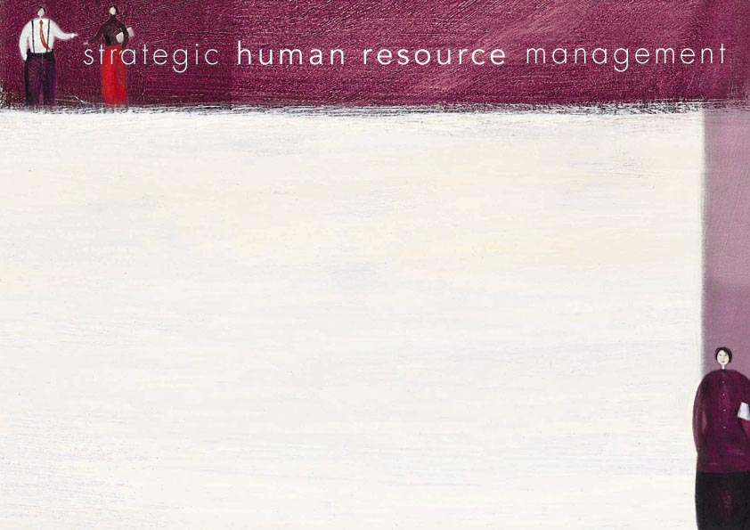
Concept of SHRM

Slide 2
Personnel management vs human resource management
Personnel management:
A set of functions or activities
Human resource management:
An integrated set of personnel activities, linked strategically with organizational objectives

Slide 3
History and origins of HRM
HRM has existed since the beginning of time
Developed formally as a result of the Industrial Revolution
Working conditions became a social and industrial issue
Growth of trade unions and IR systems

Slide 4
HRM – roles, functions and strategies
Strategic
Operational
Functional

Slide 5
Strategic HRM
Responsiveness to competition and globalization
Alignment to business strategy
Quality HRM practices
Management of change

Slide 6
HRM issues
Quantity and quality of employees
Strategic recruitment and selection practices
Retention
Productivity and motivation
Job design
Integration and accountability of functions
Evaluation

Slide 7
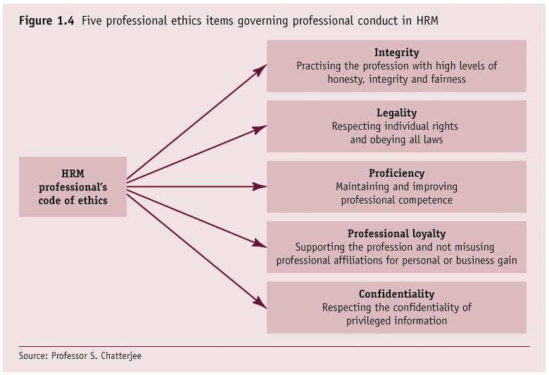

Slide 8
HRM – the future
Devolution
Automation
Outsourcing

